Slide 1
Dynamic Deliveries
What is the product?
Restaurant delivery website
Consolidation of restaurants across multiple platforms
GrubHub
DoorDash
UberEats
Shopping cart
Django
Data mining
Python
Scrapy – An open source web crawling framework
Can be used to extract data using APIs
Security
Https
Django
UI
Bootstrap

Slide 2
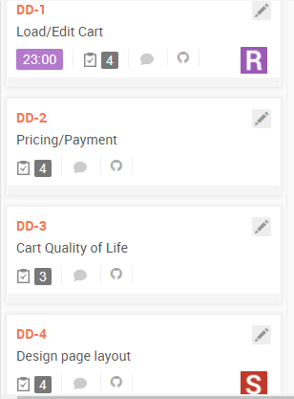
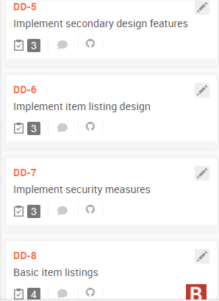
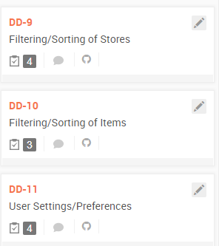
Stories

Slide 3
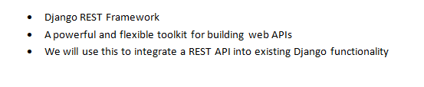
Web Service

Slide 4
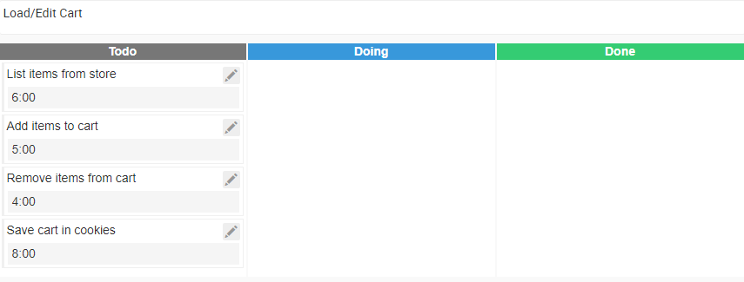
Tasks

Slide 5
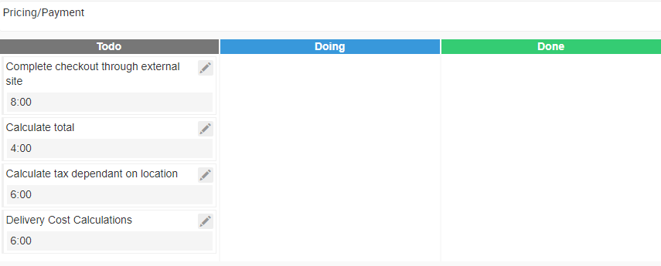
Tasks

Slide 6
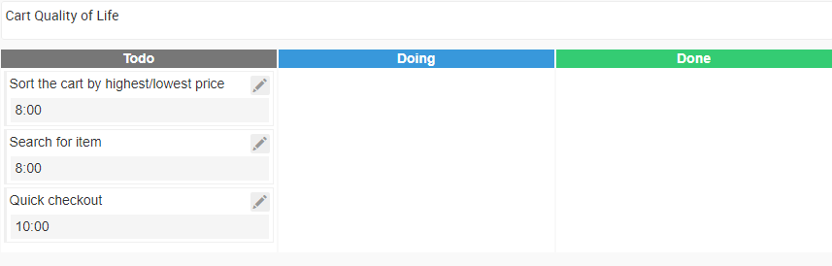
Tasks

Slide 7
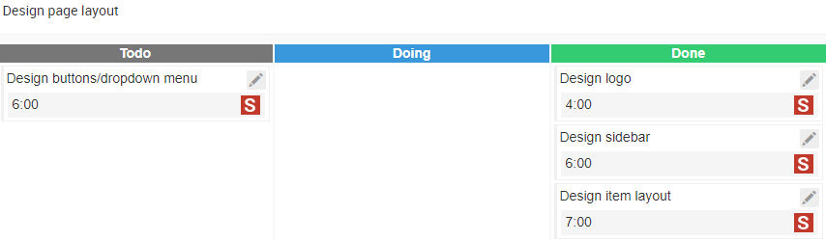
Tasks

Slide 8

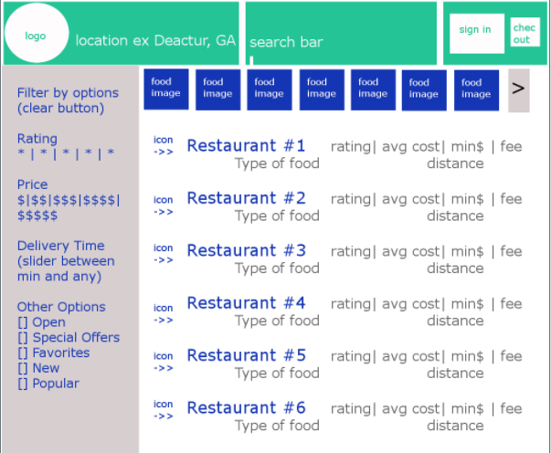
Logo and Main Page

Slide 9
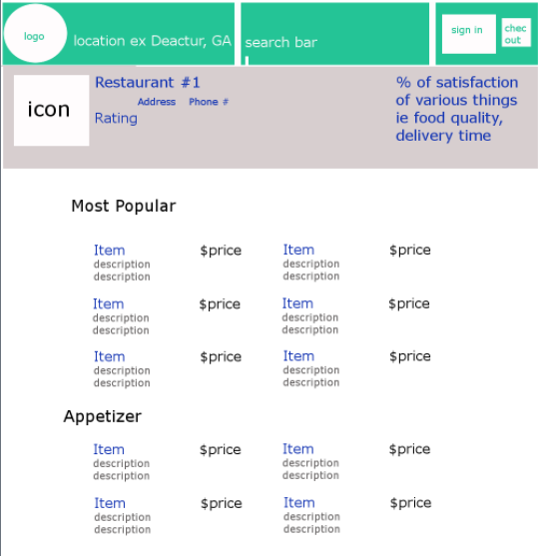
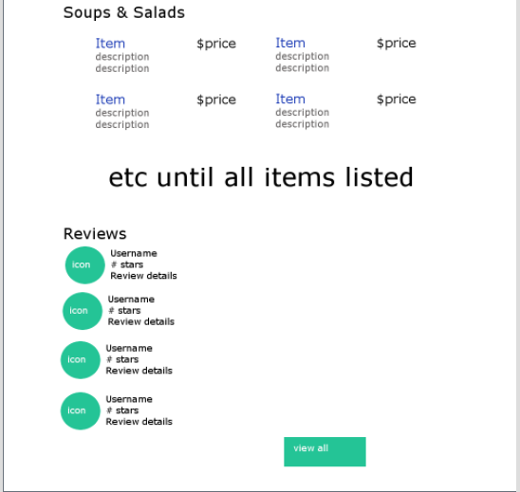
Food Page

Slide 10
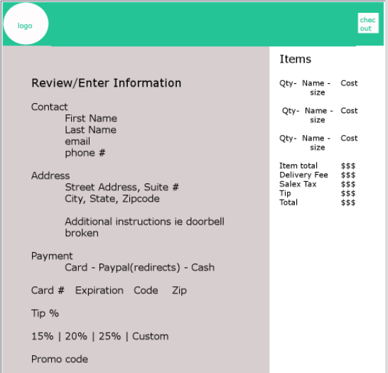
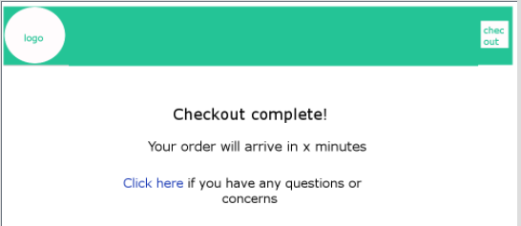
Checkout Page

Slide 11
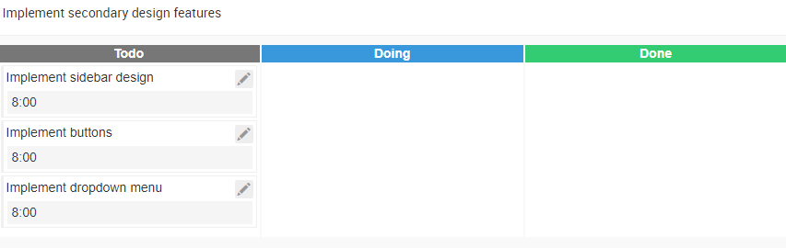
Tasks

Slide 12
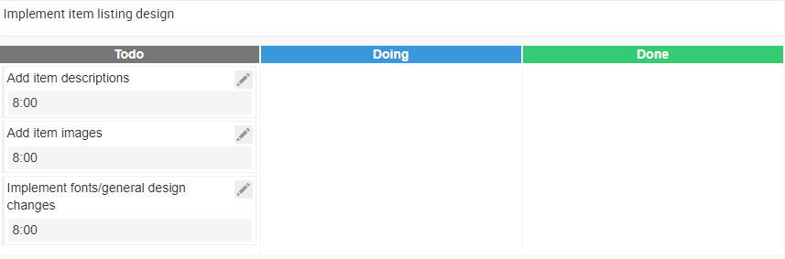
Tasks

Slide 13
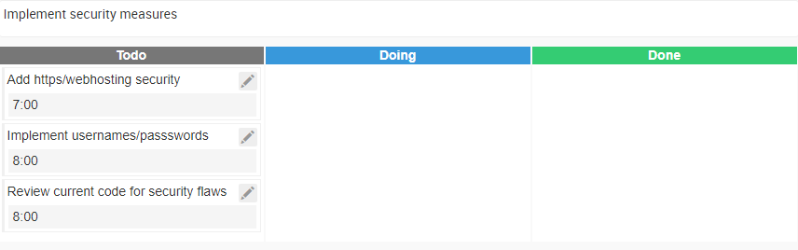
Tasks

Slide 14
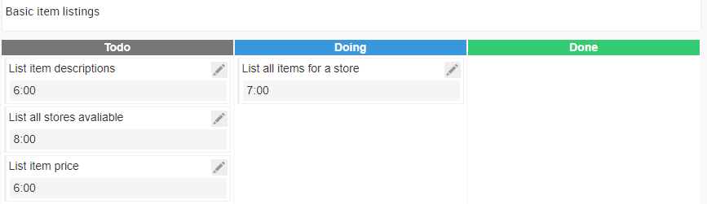
Tasks

Slide 15
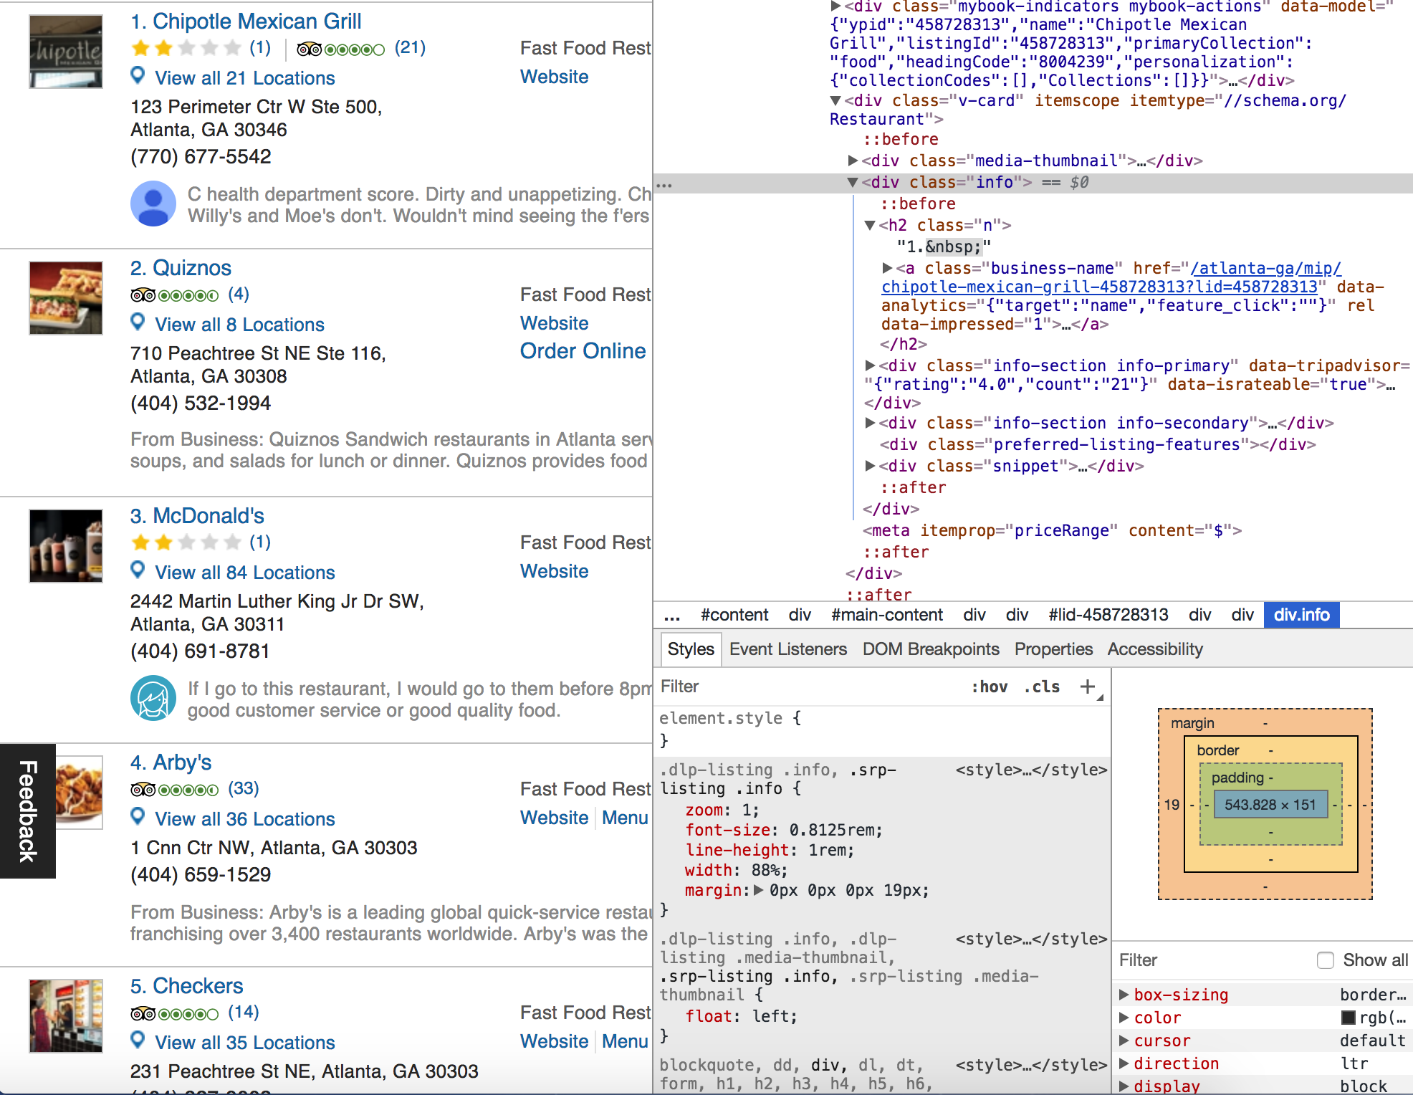
This is one of the websites we’re scraping data from.
This is where we’re getting the list of restaurants.
The right side is the html code that we’re using to determine the paths to names.
So far we have scraped all the information from this website

Slide 16

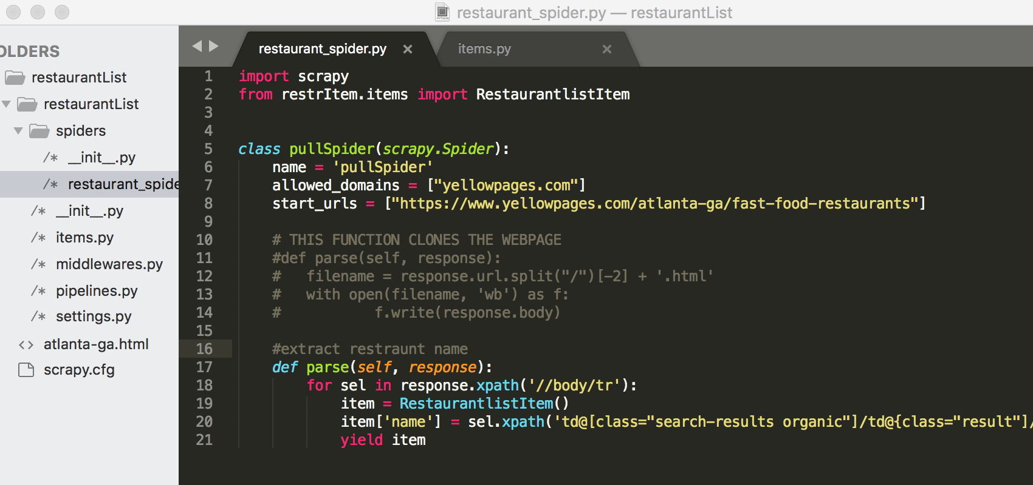
This is the framework we used to scrape the data.
Here’s a snippet of the code used to pull the names of the restaurants. It doesn’t work 100% yet, but it’s almost there. The commented out portion was used to gather the whole page, and the function under that is what we’re working on to get the individual names.

Slide 17
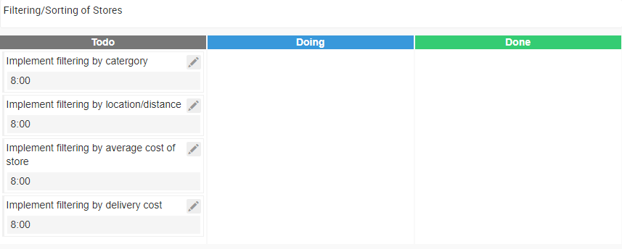
Tasks

Slide 18
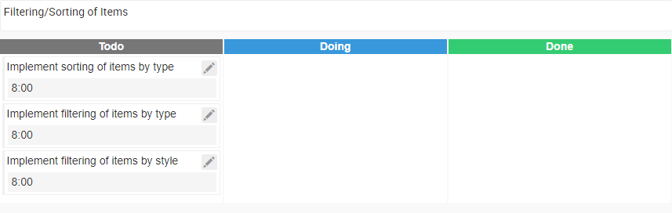
Tasks

Slide 19
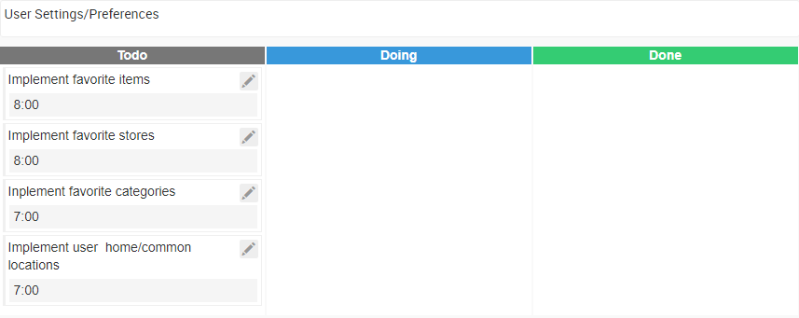
Tasks

Slide 20
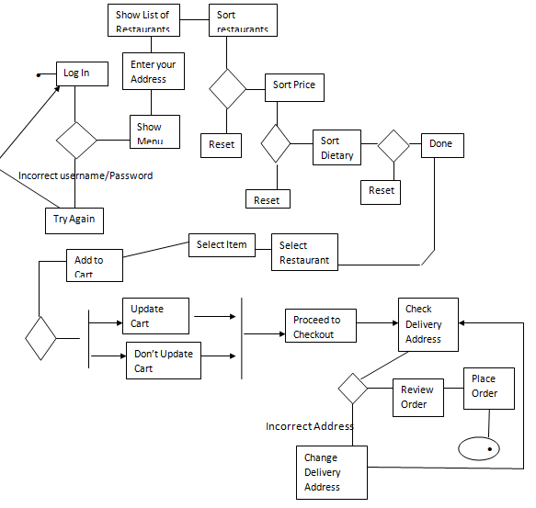

Slide 21
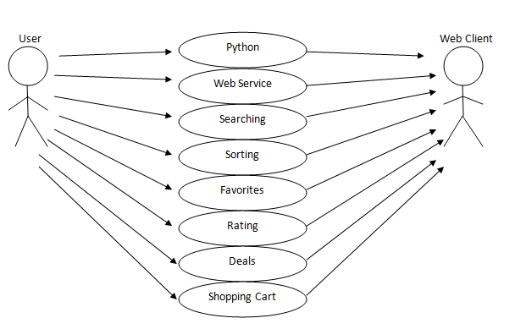
Overall System(10,000 Level)

Slide 22
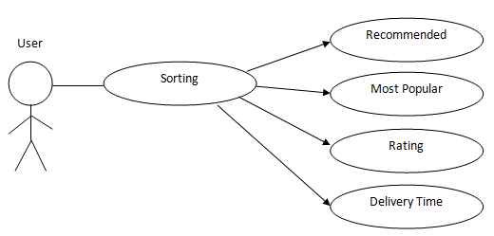
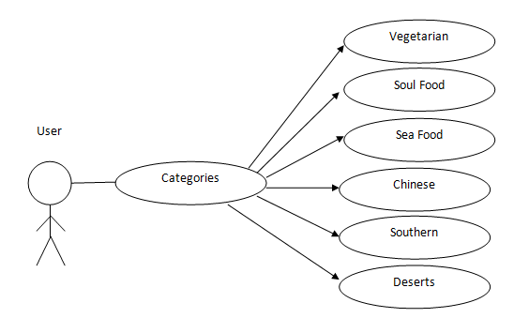
100 Level

Slide 23
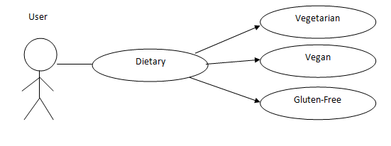
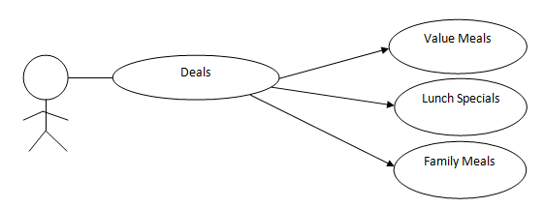
100 Level continued

Slide 24
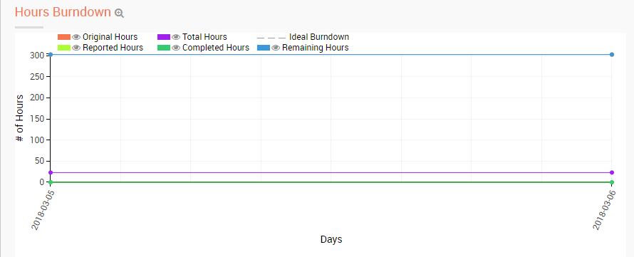
Burndown

